Slide 1
12th Grade Course Request
Course Request 2022-2023

Slide 2
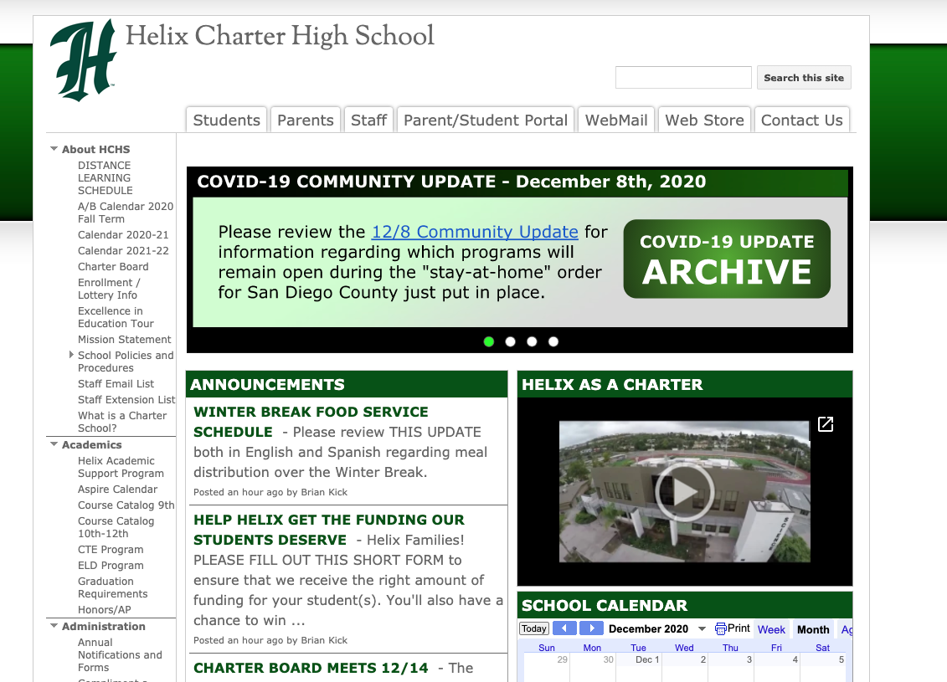
Course Catalog for 2022-2023
www.helixcharter.net

Slide 3
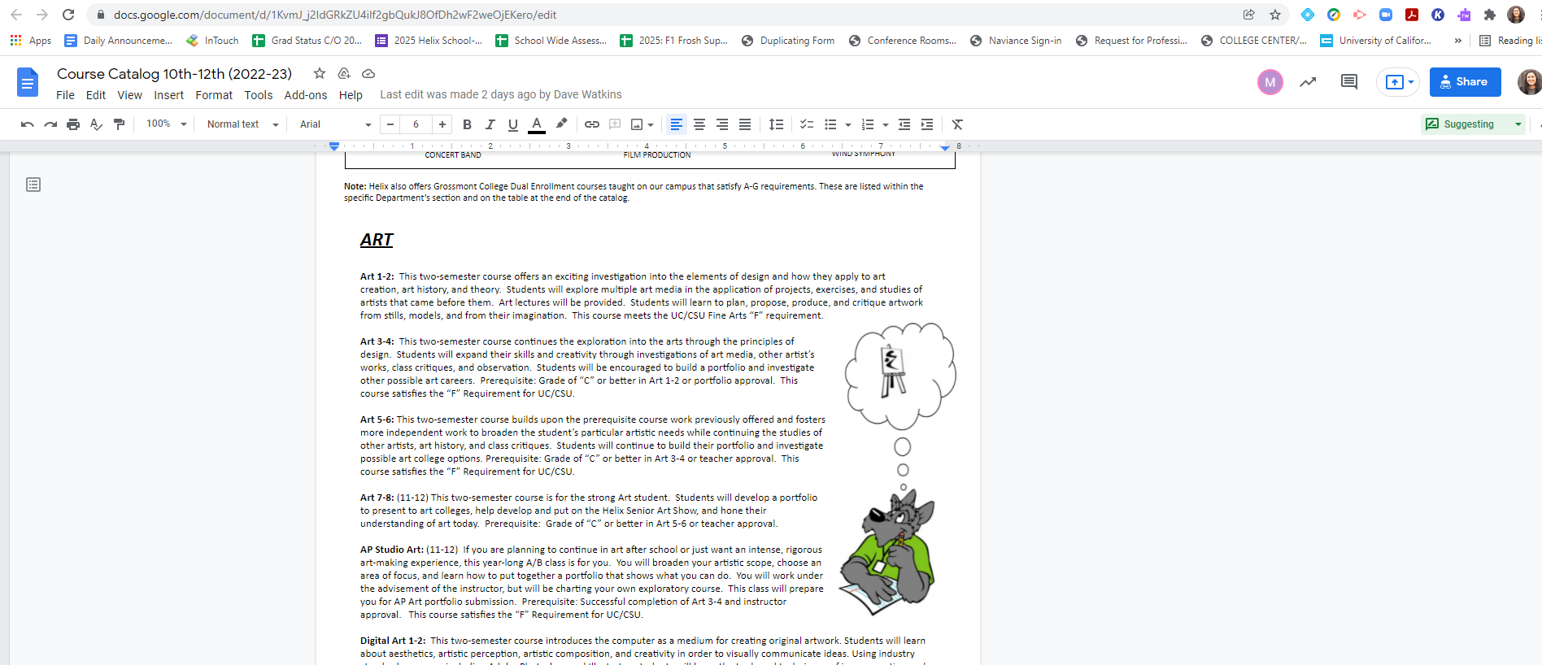
Course Catalog for 2022-2023

Slide 4
Course Catalog for 2022-2023
Prerequisite
Requirement fulfilled

Slide 5
A-G CLASSES
AT HELIX

Slide 6
UC/CSU COURSE (A-G SUBJECTS) REQUIREMENTS
AREA A: HISTORY/SOCIAL SCIENCE Two years required | 2 Semesters - World History/European History/Hist 137/Hist 155 2 Semesters - US History/AP US History/Hist 181/Hist 119
AREA B: ENGLISH Four years required | 8 Semesters
AREA C: MATHEMATICS Three years required | 6 Semesters - Including Completion of Geometry and Algebra II
AREA D: SCIENCE Two years of lab science | 2 Semesters - Biology or Biotech 1/2 2 Semesters - Physical Science (Chemistry, Physics, or Biotech ¾)
AREA E: LANGUAGE OTHER THAN ENGLISH (LOTE) Two years required | 4 Semesters of the Same Language (Spanish, French, or ASL) (Spanish for Spanish Speakers, college-level courses and ¾ level courses fulfill this requirement)
AREA F: VISUAL & PERFORMING ART One year required | 2 Semesters - Chosen from Dance, Drama/Theatre, Music or Visual Art
AREA G: ELECTIVE One year required | 2 Semesters - Chosen from “A-F” courses beyond those used to satisfy the requirements above or courses that have been approved solely in the elective area
Political Science | 1 Semester
Economics | 1 Semester

Slide 7
ADDITIONAL HELIX REQUIREMENTS
2 Years of PE | 9th Grade PE + one more year of PE/Dance/Marching PE/2 seasons of a Helix sport during 10th-12th grade.
TECH FOUNDATIONS | 1 Semester
SENIOR BOARDS | TBD
COMMUNITY SERVICE | 30 Hours
POST SECONDARY TESTING REQUIREMENT | SAT, ACT, PSAT or ASVAB
FAFSA/CADAA | New state requirement for the 2022-2023 school year
COLLEGE LEVEL EXPERIENCE | By earning college credit through Advanced Placement (AP), College-Level Course, Articulated Course

Slide 8
“A” REQUIREMENT
History
2 years required

Slide 9
AREA “A” REQUIREMENT
Most students will complete this requirement by the end of 11th grade.
Must complete:
World History
World History 1C/2C
AP European History
History 137 or History 155 (or other college World History class)
US History
US History 1C/2C
AP US History
History 119 or 181 (or other college US History class)

Slide 10
“B” REQUIREMENT
English
4 years required

Slide 11
12th GRADE - AREA “B” REQUIREMENT
Level | Course Title | Length Type | Prerequisite/Notes
College Prep | Theory and Practice of Literature (Creative Writing) English for Business Expository Reading & Writing (ERWC) Hip Hop Literature Literature of Sports Science Fiction Literature | 2 Semesters | None
*Must complete 9th, 10th and 11th grade English to meet graduation requirements
Notes:
Update

Slide 12
12th GRADE - AREA “B” REQUIREMENT
Level | Course Title | Length Type | Prerequisite/Notes
College-Level | ENG 120: College Composition & Reading ---------------- ENG 124: Advanced Composition: Critical Reading & Writing (must have taken ENG 120) —-------------- ENG 122: Introduction to Literature (must have taken ENG 120) —-------------- ENG 236: Chicana/Chicano Literature | College Course | Must meet placement prerequisites
*Must complete 9th, 10th and 11th grade English to meet graduation requirements
Notes:
Update

Slide 13
“C” REQUIREMENT
Mathematics
3 years required

Slide 14
COLLEGE PREP - AREA “C” REVIEW
9th Grade | Algebra IC (yearlong)
10th Grade | Geometry
11th Grade | Algebra IIC (yearlong) or Algebra IC if not passed
12th Grade | Statistics 1/2C AP Statistics Intro to Data Science (New Class) Algebra 2C (if did not pass in 11th Grade) Geometry (if did not pass in 10th Grade)
Notes:
If student failed Geometry, students will need to request Algebra 2 for 11th grade and take Geometry in 12th grade.

Slide 15
HONORS - AREA “C” REVIEW
Honors Algebra I
Honors Geometry
Honors Algebra II
Honors Pre Calculus
AP Calculus AB & BC - Yearlong Everyday
Math 281: Multivariable Calculus
AP Statistics - Yearlong A/B
*Honors students must earn a “B” or higher to continue in Honors courses*

Slide 16
“D” REQUIREMENT
Science
2 years required

Slide 17
AREA “D” REVIEW
Level | Course Title
Biological Science | Biology 1/2C Biology 1/2H Biotechnology 1C/2C AP Biology
Physical Science | Biotechnology 3C/4C Chemistry 1/2C Chemistry 1/2H Physics 1/2C
Other science elective courses available (check prerequisites):
Oceanography
Physiology (Anatomy)
Chemistry 120
AP Environmental Science

Slide 18
“E” REQUIREMENT
Language Other Than English
(LOTE)
2 years required

Slide 19
Level | Course Title | Length Type | Prerequisite/Notes
FIRST YEAR OPTIONS (1/2C)
College Prep | American Sign Language (ASL) 1C/2C French 1C/2C Spanish 1C/2C | 2 Semesters | None
SECOND/THIRD YEAR OPTIONS
College Prep | American Sign Language (ASL) 3C/4C French 3C/4C Spanish 3C/4C ------------------------------------- Spanish for Spanish Speakers 1C/2C | 2 semesters ------------- 2 Semesters | Must pass first year ------------------ Pass placement test
College Level | ASL 120: ASL I FRN 120: French SPAN 120: Spanish I - - - - - - - - - - - - - - - - ASL 121/122: ASL II with Lab FRN 121: French II FRN 220: French III SPAN 121: Spanish II SPAN 220: Spanish III | College Course | A or B in Helix LOTE 1/2C class or passing placement test - - - - - - - - - - - - - - C or better in 120 course or A or B in Helix 3/4C class

Slide 20
“F” REQUIREMENT
Visual & Performing Art
1 year required

Slide 21
VISUAL & PERFORMING ART COURSES
College Prep | Art ½ Digital Art ½ Fashion and Interior Design Film Production Theatre ½ Advanced Drama (audition only) Choir (audition) Band (audition) Jazz Ensemble (audition) Orchestra (audition) Percussion (audition) Beginning Dance Intermediate/Advanced Dance (audition) Bagpipes (audition) Colorguard (audition)

Slide 22
VISUAL & PERFORMING ART COURSES
College-Level | MUSIC 101: Music Fundamentals MUSIC 110: Great Music Listening MUSIC 126/127: Guitar MUSIC 132: Piano | College Course | No prerequisites

Slide 23
“G” REQUIREMENT
College Prep Elective
1 year required

Slide 24
COLLEGE PREP ELECTIVE
 | REQUIRED COURSES BOTH SUBJECTS MUST BE TAKEN
 | Economics Options | Political Science Options
College Prep | Economics 1C | Political Science 1C
College Level | ECON 120: Macroeconomics ECON 121: Microeconomics | POSC 121: Intro to US Gov & Politics POSC 124: Intro to Comparative Gov & Politics
You may mix and match levels between the two subject areas.
Example: Econ 1C and POSC 121

Slide 25
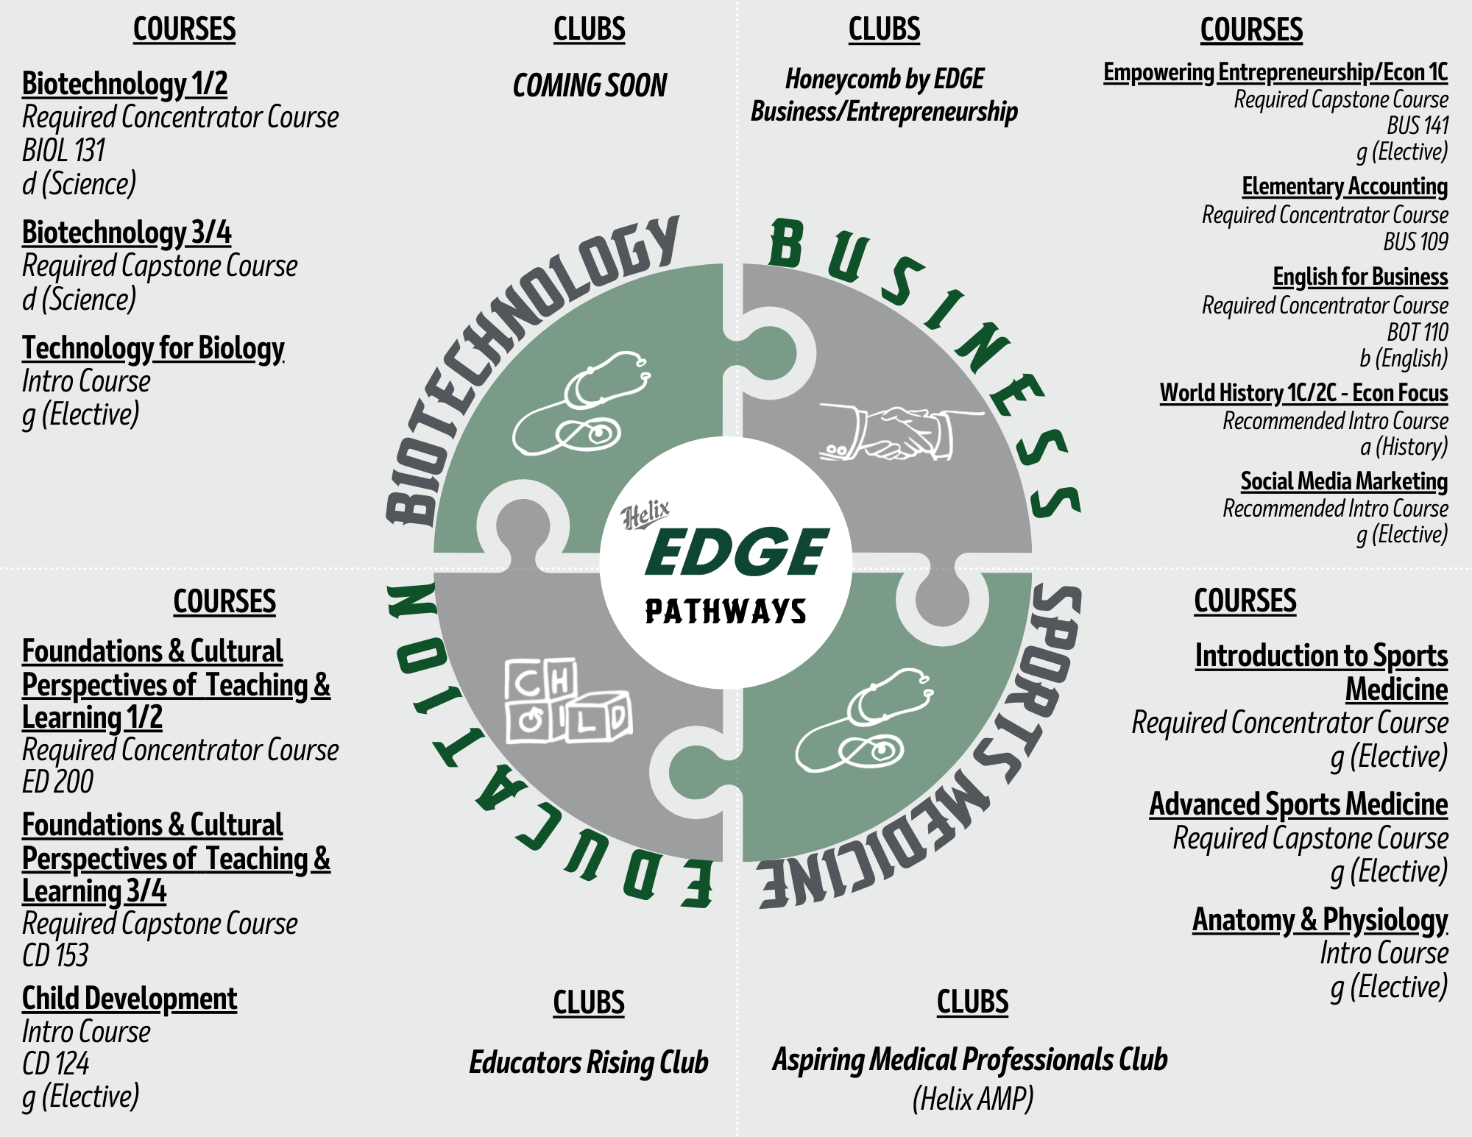
EDGE Pathways (CTE)
Notes:
Articulated course for T&L and Entrepreneurship ended; awaiting news about renewal

Slide 26
APPROVED 7th & 8th COURSE
Students can take a MAXIMUM of 6 classes per school year.
The following courses are approved as additional 7th/8th classes:
Orchestra
Speech or Debate
ASB (Application Required)
Yearbook (Application Required - midyear only)
Dance (Auditions required for advanced placement)
Theater (Auditions required for advanced placement)
Journalism
Academic Support
Bagpipes
Band
Choir
Colorguard
Marching PE
EDGE Makers Lab
Helix First Peer Mentor
Super Scotties

Slide 27
COURSE SELECTION PROCESS
Submit Course Request Form by Sunday, January 30th
Senior Course Request Checklist:
Begin reviewing Course Catalog at home with your student (Helix Website: Course Catalog)
Students will continue to receive information via Advisory lessons about Course Request materials for next year
Students must submit Course Request Form by Sunday, January 30th
Students will meet with the Grade Level Team starting February through March to finalize/approve Course Selections (Before Spring Break)
Last day to make any changes to the course requests is Thursday, March 10th

Slide 28
COURSE SELECTION PROCESS CONT.
Your course request in StuVue will BE the courses you would like to TAKE next year
Make sure you meet any prerequisite requirement & plan to retake any 10th or 11th grade classes you failed
You CANNOT change course selections once we leave for Spring Break
All changes must be made via email to BOTH Mrs. Gunion (gunion@helixcharter.net) and Ms. Meza (meza@helixcharter.net)

Slide 29
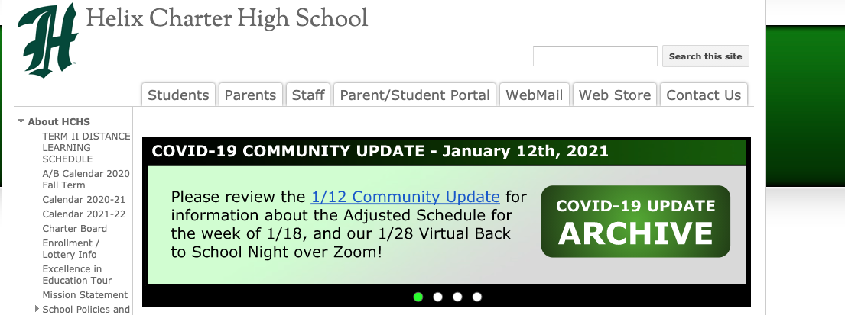
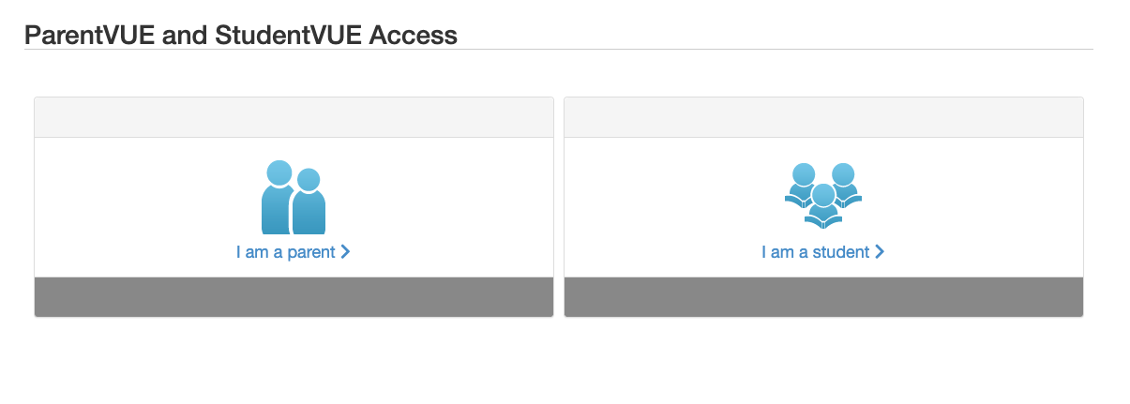
View Course Selection on StudentVue/ParentVue during February and March
NOTE: Students and Families WILL NOT be able to make changes through their StudentVue/ParentVue. All changes must be made with Mrs. Gunion and Ms. Meza

Slide 30
THANKS!
Mrs. Gunion- Counselor gunion@helixcharter.net
Ms. Meza- Academic Advisor meza@helixcharter.net

